Slide 1

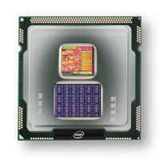

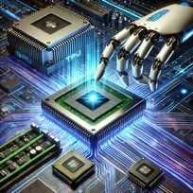
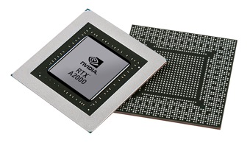


Christof Teuscher
ECE 410/510: Hardware for AI and ML
Course organization and details
Portland State University
Department of Electrical and Computer Engineering (ECE)
www.teuscher-lab.com
teuscher@pdx.edu

Slide 2
This is an experiment
Anything can change anytime.
Failure is an option.
Students will not be carrying the risk.

Slide 3
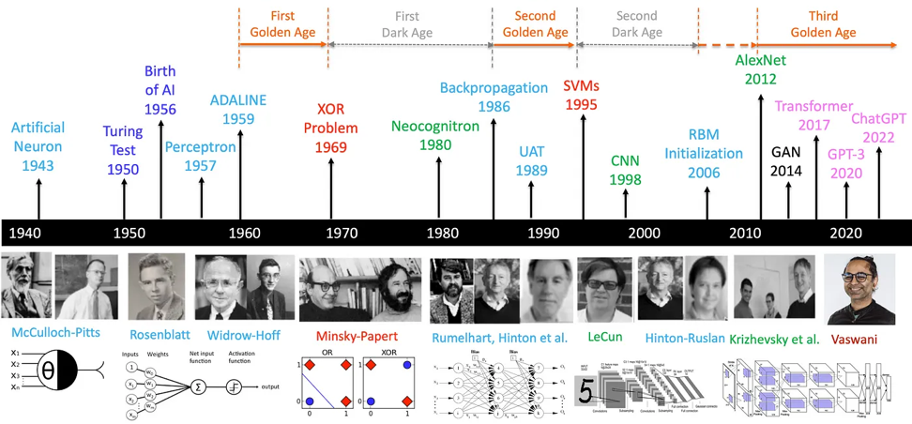
Once upon a time…
Systems Science & ECE professor George Lendaris retired in 2011.
With him, the one and only neural network course we offered died because there was not enough interest.
https://medium.com/@lmpo/a-brief-history-of-ai-with-deep-learning-26f7948bc87b

Slide 4
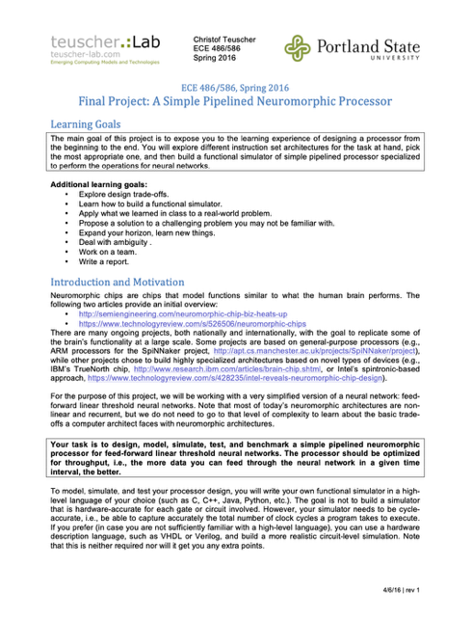
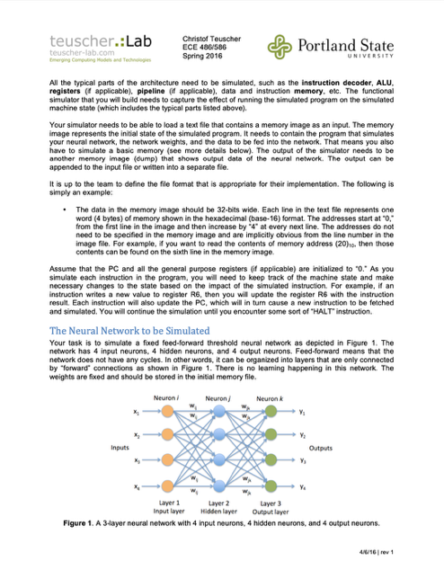
2016
ECE 586

Slide 5
Why this course?

Slide 6

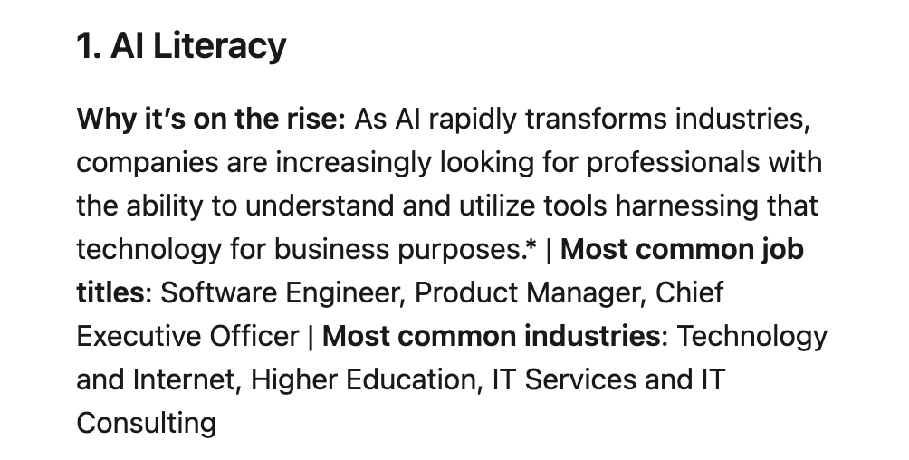
Why this course?
https://www.linkedin.com/pulse/linkedin-skills-rise-2025-15-fastest-growing-us-linkedin-news-hy0le

Slide 7
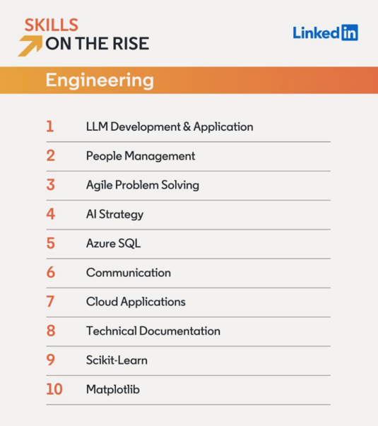
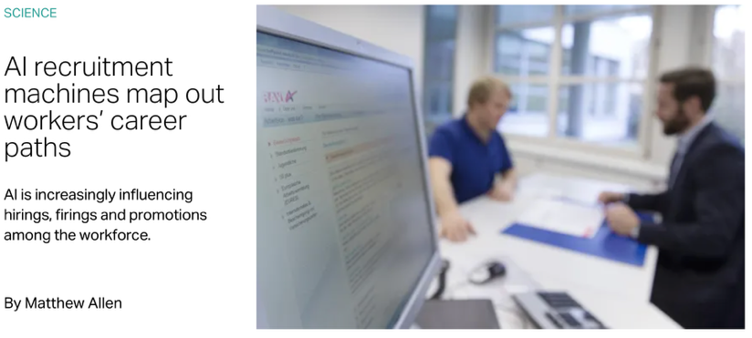

Slide 8

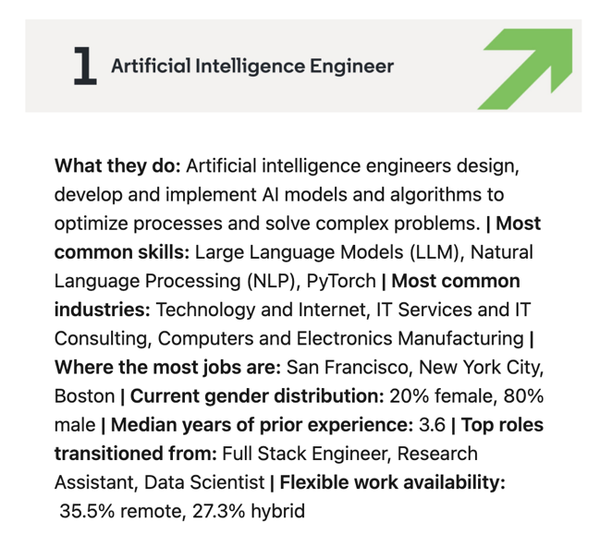
https://www.linkedin.com/pulse/linkedin-jobs-rise-2025-25-fastest-growing-us-linkedin-news-gryie

Slide 9
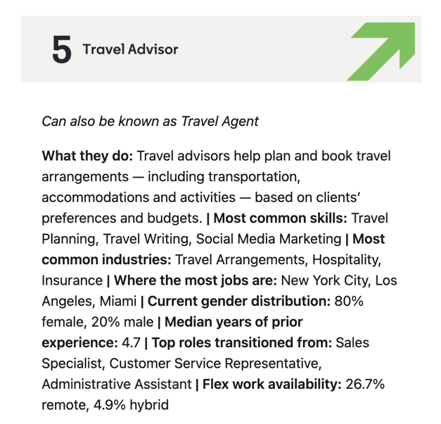
https://www.linkedin.com/pulse/linkedin-jobs-rise-2025-25-fastest-growing-us-linkedin-news-gryie

Slide 10
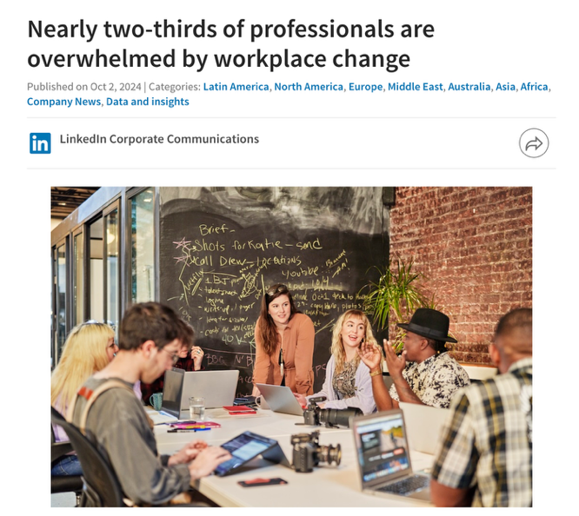
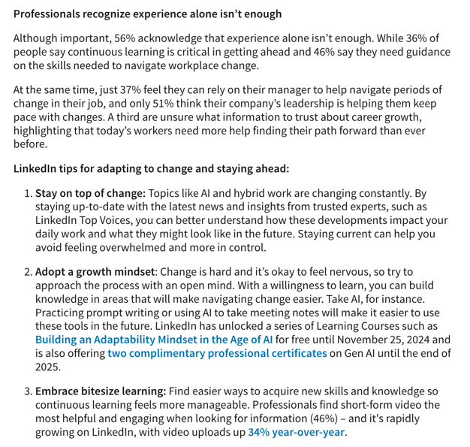
https://news.linkedin.com/2024/October/overwhelmed-by-workplace-change

Slide 11
Inspiration and course design

Slide 12
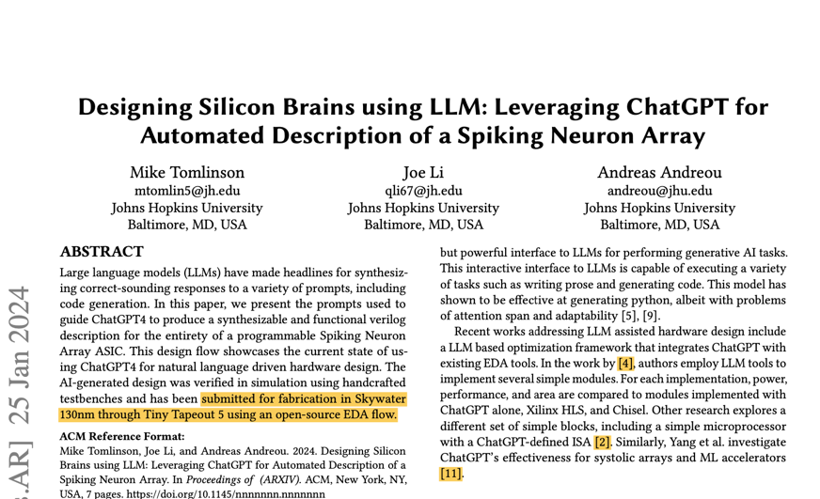
https://arxiv.org/abs/2402.10920

Slide 13
How do we teach cutting-edge
new technology?
Nothing seems linear and predictable
Everything is complex
Everything is connected
Everything moves fast

Slide 14
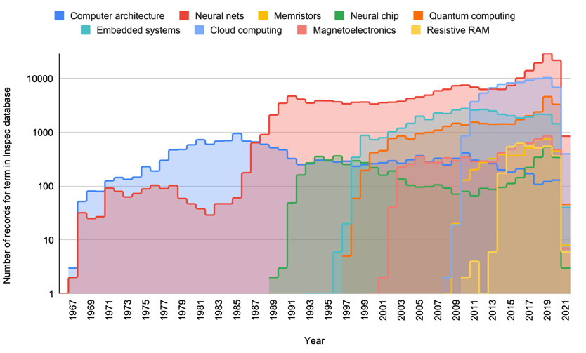

The need for new educational approaches
https://doi.org/10.1145/3457388.3458673

Slide 15
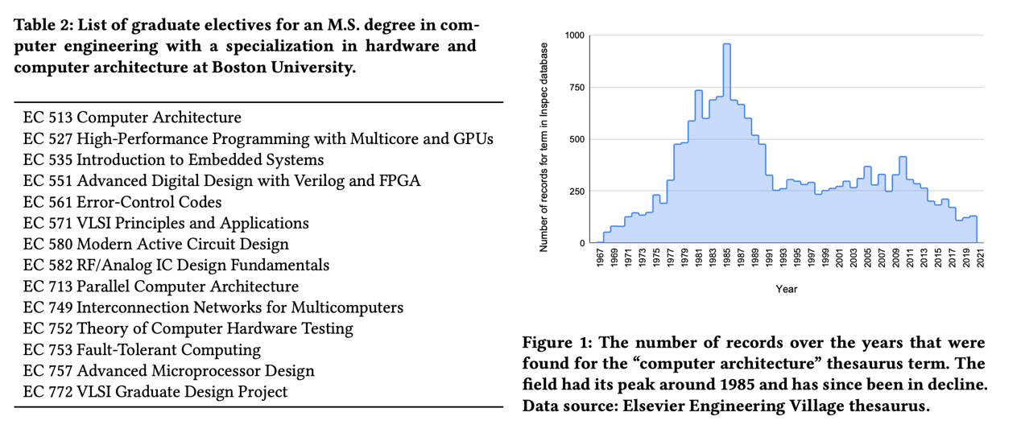

Slide 16
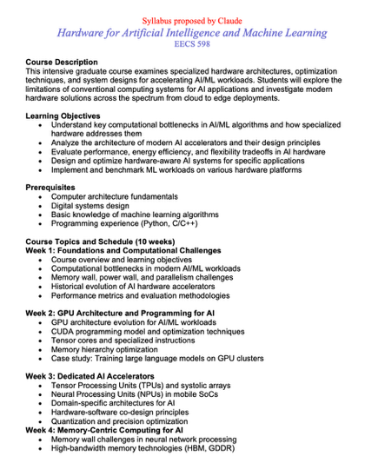
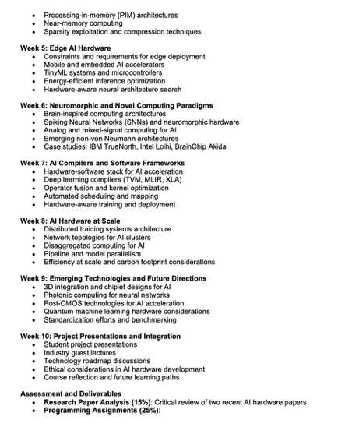
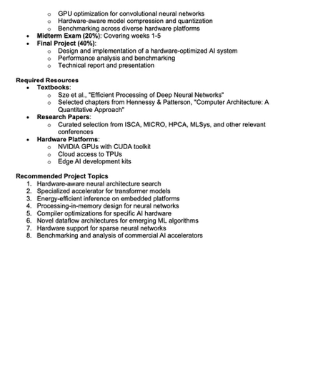
Let’s ask Claude…

Slide 17

Pillars this class is built on
You!
Foundations
Co-design
LLM
Experimentation

Slide 18
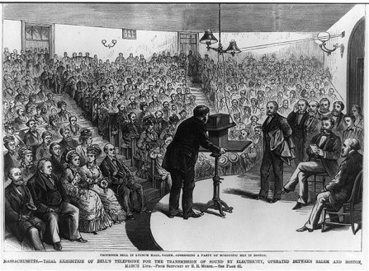
What’s the role of education?
The old model:
knowledge + skills = success
Domain-specific compartmentalization + professor with authority + lectures + fixed curriculum + assessment → terminal degree
The new model:
creative thinking
complex problem solving
the ability to learn
emotional intelligence
→ learning never ends
→ be invested in your own learning

Slide 19

What is a wicked student?

Slide 20
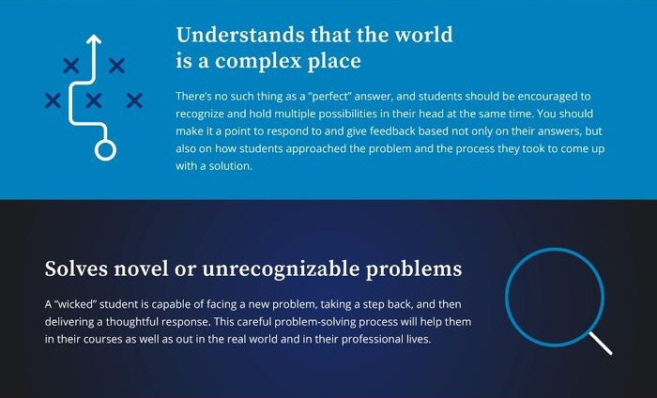

Slide 21
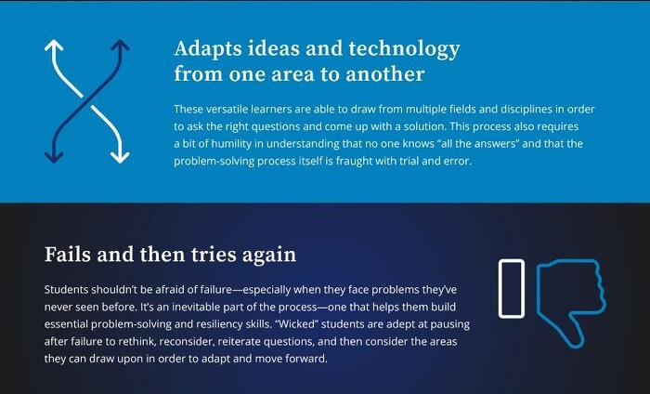

Slide 22
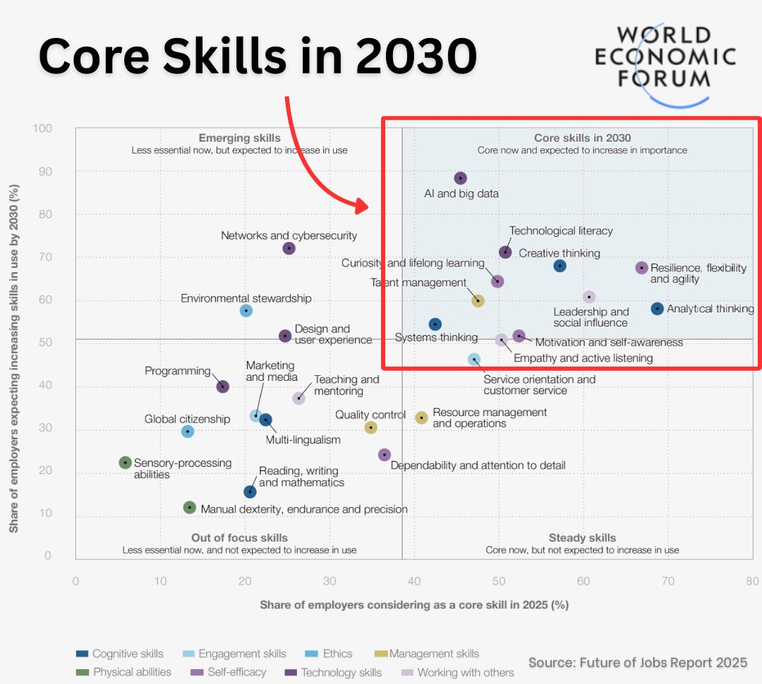

Slide 23
Let’s talk about the fine print…

Slide 24
My assumptions and expectations
Intrinsically motivated to learn about this subject.
Willing to be challenged and to get out of your comfort zone.
Willing to show up and put in the work.
Willing to not take shortcuts.
Always does a little more rather than a little less.

Slide 25

“In science, if you know what you are doing,
you should not be doing it.
In engineering, if you do not know what you are doing,
you should not be doing it.”
— Richard W. Hamming, The Art of Doing Science and Engineering: Learning to Learn.

Slide 26
A word about prerequisites
Recommendations:
Undergraduate: ECE 371 and ECE 351
Graduate: ECE 485
Ideal knowledge:
Python or other language
Github
Advanced computer architecture, incl. GPUs
FPGAs
Analog and digital circuits
Verilog, SystemVerilog
AI prompt engineering

Slide 27
Learning goals
Prepare you for a complex, fast-moving, constantly-changing world.
Understand the principles and tools for SW/HW co-design.
Understand the foundations of neural networks.
Understand the foundations of Large Language Models (LLMs).
Understand the foundations of specialized hardware for AI/ML, such as GPUs, TPU, FPGAs, and neuromorphic architectures.
Capable of mapping algorithms onto hardware.
Capable of evaluating HW designs.
Capable of optimizing HW designs through co-design for computational power, efficiency, and flexibility.
Capable of using modern SW and HW tools for designing and using specialized HW for AI/ML.

Slide 28
What this class is not
Not a class about LLM, AI, ML, ANN, etc.
…

Slide 29
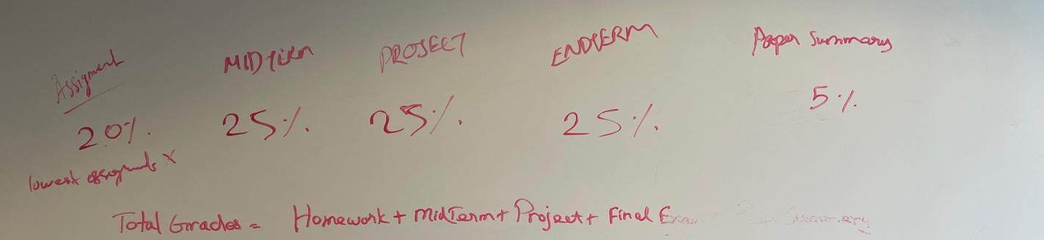
Traditional grading

Slide 30
This course is entirely self-graded
Why is that good for you?
Puts you in the driver seat.
Invest in your own learning.
Learn how to advocate for yourself.
Learn how to document and sell your progress/contributions.
Prepares you for performance evaluations in industry.
An opportunity to shine in your own way.
What is my role in this?
Ensure integrity and fairness of the process.
Intervene if necessary (over-/under-estimation of performance)

Slide 31
This course is entirely self-graded
How will this work?
Throughout this course, you will document and keep track of all your creations and contributions (e.g., Github, Wiki, Slack, etc.)
At the end the term, you will write a recommendation letter for yourself.
The letter will serve as a self-evaluation.
You will assign yourself a grade based on your contributions.
Effort doesn’t count. You need to earn your grade with tangible products. Move your own needle!

Slide 32
Additional perks
I will assess your performance holistically throughout the term using Google’s GRAD system:
Transformative Impact (TI)
Outstanding Impact (OI)
Significant Impact (SI)
Moderate Impact (MI)
Not Enough Impact (NE)
Think of this as your “probation period.” You want to get hired, so act accordingly.
OI students may ask me for a LinkedIn recommendation.
TI students may ask me for a recommendation letter.
Selected TI students may be offered a summer GRA position.

Slide 33
Will there be exams and quizzes?
Goal: provide you with opportunities to shine and stand out.
Weekly questions and problems.
Final optional oral examinations?

Slide 34
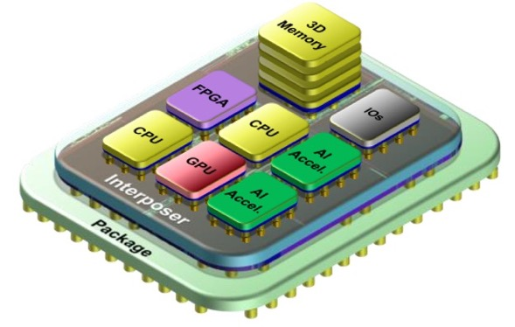
What will we do?
You will each (co-)design, test, evaluate, etc. an AI/ML accelerator for a large class-wide chiplet design.

Slide 35
A typical week
Monday
Wednesday
Monday
Codefest
Instigation

Slide 36
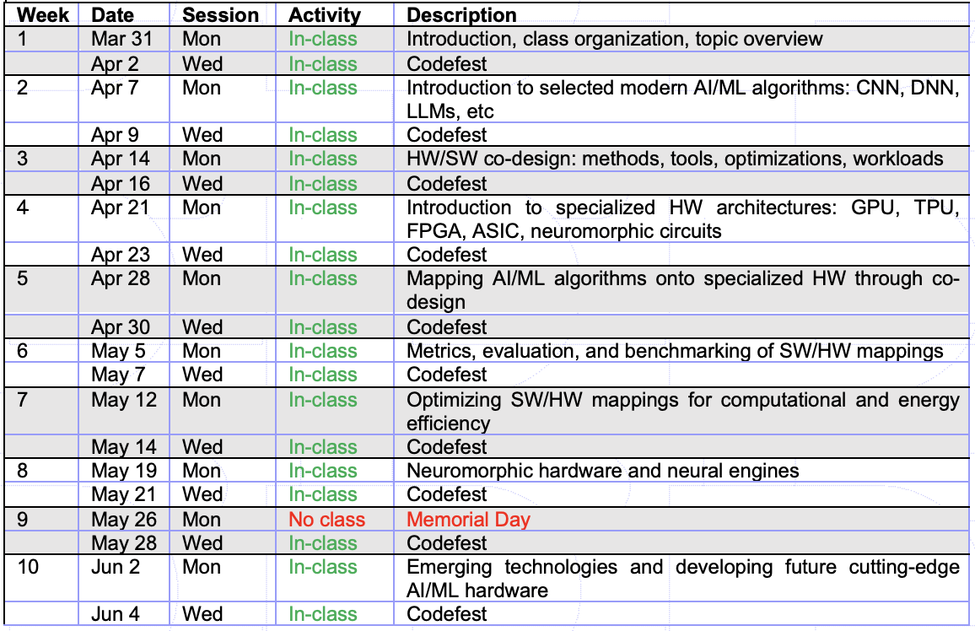
Tentative course plan

Slide 37

What will you need?
Access to your favorite LLM. No pro subscription required, but recommended.
Ability to bring and work on a laptop.

Slide 38
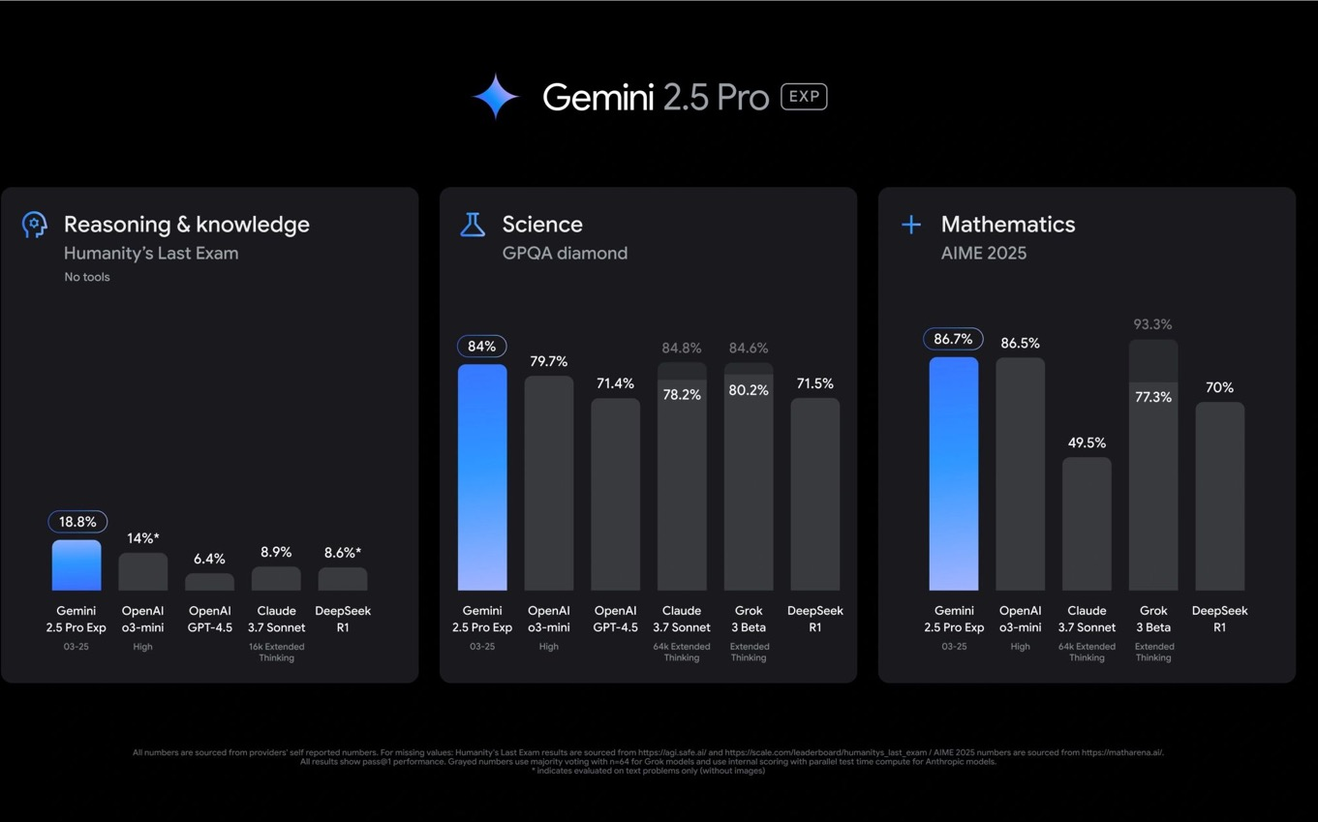
What model should I use?
What model should I use?

Slide 39
AI tools advice
Before relying heavily on any AI tool, test it on problems/topics/etc. for which you're an expert.
This simple exercise will allow you:
Calibrate your expectations of the tool's knowledge depth.
Understand its strengths and limitations.
Build intuition about its reliability on various topics
Set a baseline for how much verification you'll need in unfamiliar areas.

Slide 40
How to get help?
E-mail: teuscher@pdx.edu
Office hours: https://www.teuscher-lab.com/officehour

Slide 41
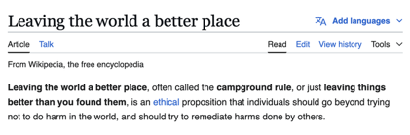
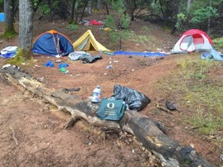
Practice the “campsite rule”
Your presence should make this classroom a better place.
Engage: listen, participate, contribute, do your share. Play fair.
Focus: no side conversations, no laptop and phone addiction, no work for other classes.
Be present: show up, be on time.
Challenge yourself: do always a little more instead of just the bare minimum. Up your game, set high standards for yourself. Produce work that you can be proud of.
Help others to be successful. That includes your team.
Willingness to learn: have a growth mindset, intellectual humility and ambition.
Be in charge: Put yourself in the driver’s seat, assume responsibility.

Slide 42
Participate in an educational study and publication
Now: complete an initial skills/knowledge assessment.
End of term: complete the same survey.
Agree to have your deliverables/products assessed.
Participate in a focus group at the end of the term.
Why participate?
Help to make this a better class for future students
Be part of the change
Co-author a publication?

Slide 43
Prep for Wednesday
Bring your laptop
Accept the Slack invite (to be sent)
Create a wiki account (to be shared)
Github (to be shared)
Reading:
Designing Silicon Brains using LLM: Leveraging ChatGPT for Automated Description of a Spiking Neuron Array, https://arxiv.org/abs/2402.10920

